Slide 1
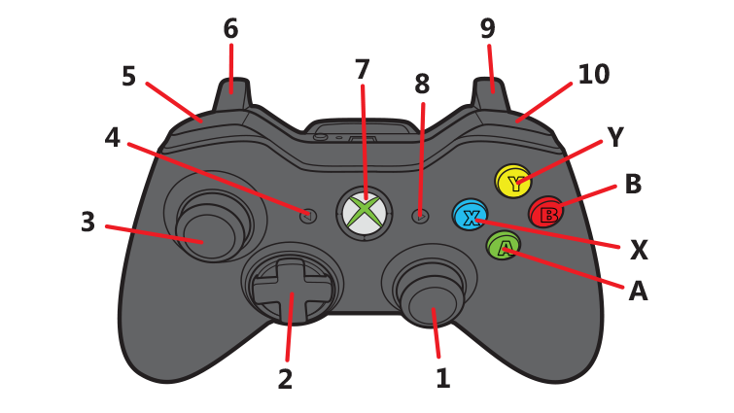

Slide 2
Values to send to Arduino
Description | Mode | Value
Manual FWD vel | 0 | 0-255
Manual REV vel | 1 | 0-255
Automatic FWD vel | 2 | Speed_H, Speed_L
Automatic REV vel | 3 | Speed_H, Speed_L

